Slide 1
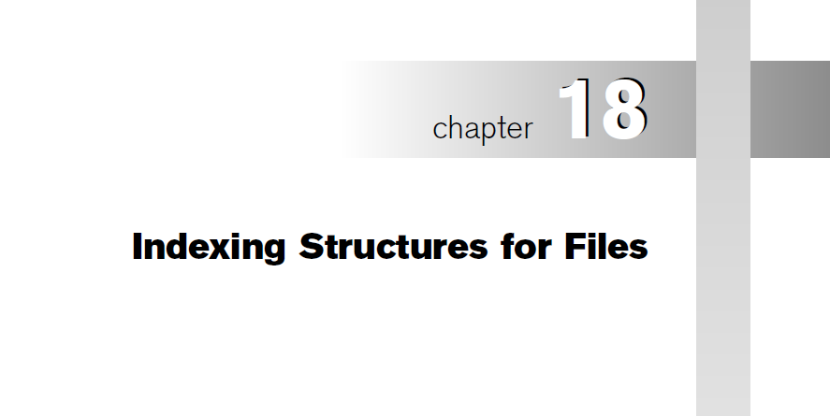
Slide 14- <number>

Slide 2
Chapter Outline
Indexes as additional auxiliary access structure
Types of Single-level Ordered Indexes (ordered files)
  Primary Indexes
  Clustering Indexes
  Secondary Indexes
Multilevel Indexes
Dynamic Multilevel Indexes Using B-Trees and B+-Trees
Indexes on Multiple Keys

Slide 3
Indexes as Access Paths
A single-level index is an auxiliary file that makes it more efficient to search for a record in the data file.
The index is usually specified on one field of the file (although it could be specified on several fields)
One form of an index is a file of entries <field value, pointer to record>, which is ordered by field value
The index is called an access path on the field.

Slide 4
Indexes as Access Paths (contd.)
The index file usually occupies considerably less disk blocks than the data file because its entries are much smaller
A binary search on the index yields a pointer to the file record
Indexes can also be characterized as dense or sparse
  A dense index has an index entry for every search key value (and hence every record) in the data file.
  A sparse (or nondense) index, on the other hand, has index entries for only some of the search values

Slide 5
Indexes as Access Paths (contd.)
Example: Given the following data file EMPLOYEE(NAME, SSN, ADDRESS, JOB, SAL, ... )
Suppose that:
  record size R=150 bytes block size B=512 bytes r=30000 records
Then, we get:
  blocking factor Bfr= floor(B div R)= 512 div 150= 3 records/block
  number of file blocks b= (r/Bfr)= (30000/3)= 10000 blocks
For an index on the SSN field, assume the field size V_{SSN}=9 bytes, assume the record pointer size P_{R}=7 bytes. Then:
  index entry size R_{I}=(V_{SSN}+ P_{R})=(9+7)=16 bytes
  index blocking factor Bfr_{I}= B div R_{I}= 512 div 16= 32 entries/block
  number of index blocks b= (r/ Bfr_{I})= (30000/32)= 938 blocks
  binary search needs log₂bI= log₂938= 10 block accesses
  This is compared to an average linear search cost of:
    (b/2)= 30000/2= 15000 block accesses
  If the file records are ordered, the binary search cost would be:
    log₂b= log₂30000= 15 block accesses

Slide 6
Types of Single-Level Indexes
Primary Index
  Defined on an ordered data file
  The data file is ordered on a key field
  Includes one index entry for each block in the data file; the index entry has the key field value for the first record in the block, which is called the block anchor
  A similar scheme can use the last record in a block.
  A primary index is a nondense (sparse) index, since it includes an entry for each disk block of the data file and the keys of its anchor record rather than for every search value.
Disadvantage - as any ordered file – insertion/deletion of records.
move records to make space for the new record + change some index entries

Slide 7
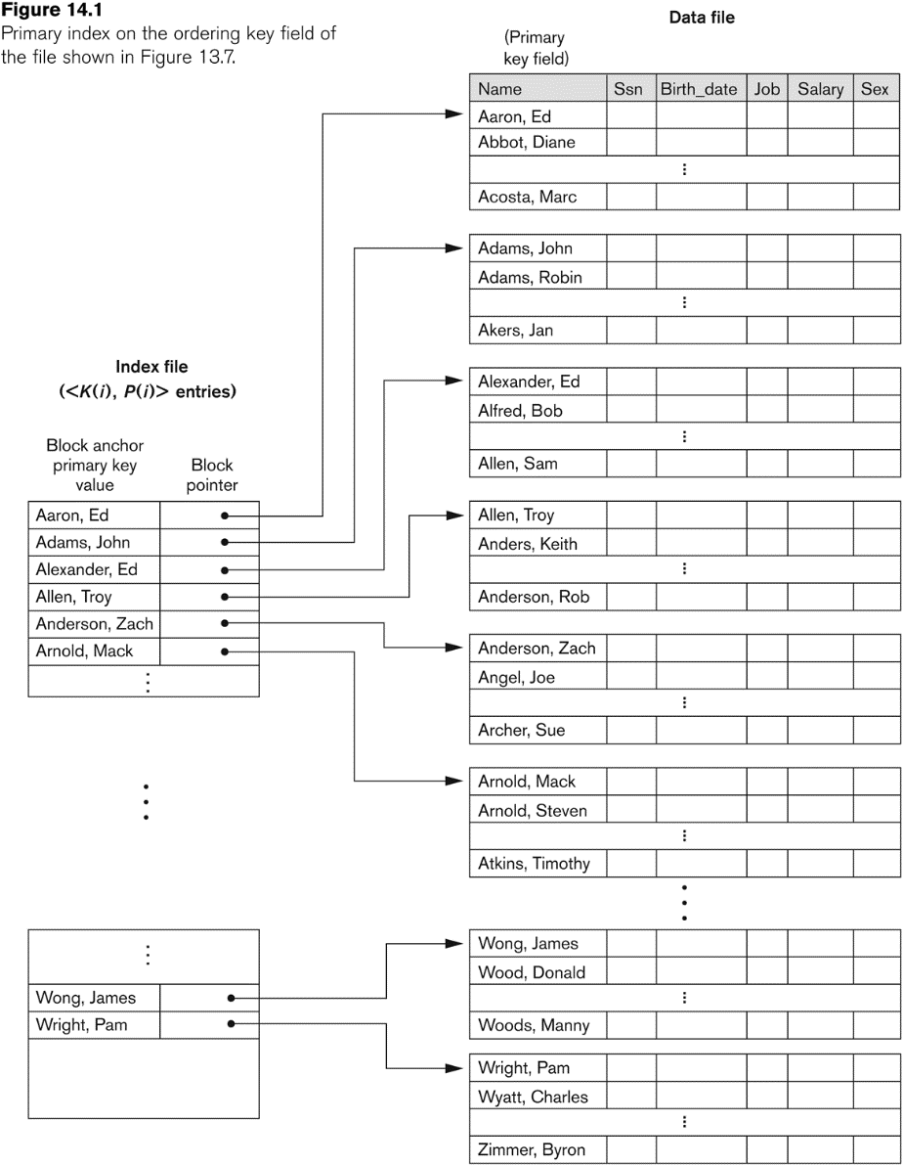
Primary index on the ordering key field

Slide 8
Primary Indexes Example
Example: Given the following data file EMPLOYEE(NAME, SSN, ADDRESS, JOB, SAL, ... )
Suppose that:
  record size R=100 bytes block size B=1024 bytes r=30000 records
Then, we get:
  blocking factor Bfr= floor(B div R)= 1024 div 100= 10 records/block
  number of file blocks b= (r/Bfr)= (30000/10)= 3000 blocks
For an index on the SSN field, assume the field size V_{SSN}=9 bytes, assume the record pointer size P_{R}=6 bytes. Then:
  index entry size R_{I}=(V_{SSN}+ P_{R})=(9+6)=15 bytes
  index blocking factor Bfr_{I}= B div R_{I}= 1024 div 15= 68 entries/block
  Total no of index entries (r_{I})= total no of blocks in data file
  number of index blocks b= ceil(r_{I}/ Bfr_{I})= (3000/68)= 45 blocks
  binary search needs log₂bI= log₂45= 6 block accesses
  This is compared to an average linear search cost of:
    (b/2)= 30000/2= 15000 block accesses
  If the file records are ordered, the binary search cost would be:
    log₂b= log₂30000= 15 block accesses
  To search for a record 6+1 block accesses needed

Slide 9
Types of Single-Level Indexes
Clustering Index
  Defined on an ordered data file
  The data file is ordered on a non-key field unlike primary index
  does not have distinct value for each record of the data file
  Includes one index entry for each distinct value of the field; the index entry points to the first data block that contains records with that field value.
  It is another example of nondense index where Insertion and Deletion is relatively straightforward with a clustering index.

Slide 10
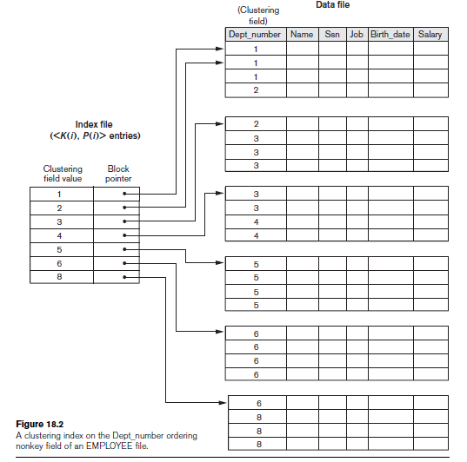
A Clustering Index Example
FIGURE 14.2
A clustering index on the DEPTNUMBER ordering non-key field of an EMPLOYEE file.

Slide 11
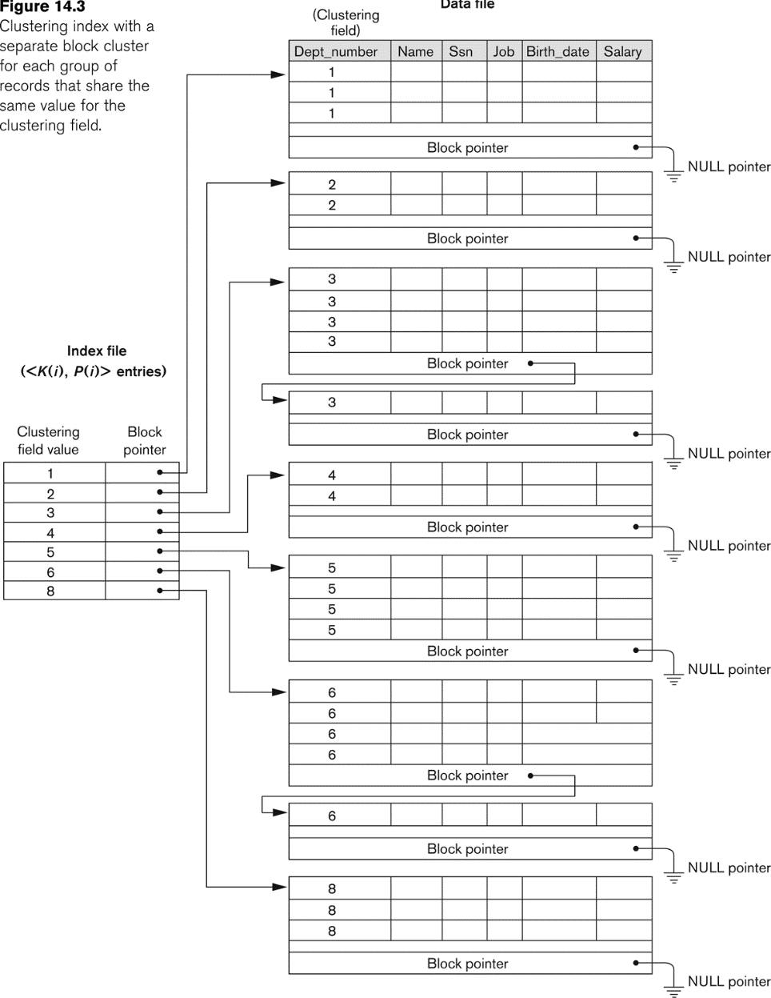
Another Clustering Index Example

Slide 12
Types of Single-Level Indexes
Secondary Index
  A secondary index provides a secondary means of accessing a file for which some primary access already exists.
  The secondary index may be on a field which is a candidate key and has a unique value in every record, or a non-key with duplicate values.
  The index is an ordered file with two fields.
    The first field is of the same data type as some non-ordering field of the data file that is an indexing field.
    The second field is either a block pointer or a record pointer.
    There can be many secondary indexes (and hence, indexing fields) for the same file.
  Includes one entry for each record in the data file; hence, it is a dense index

Slide 13
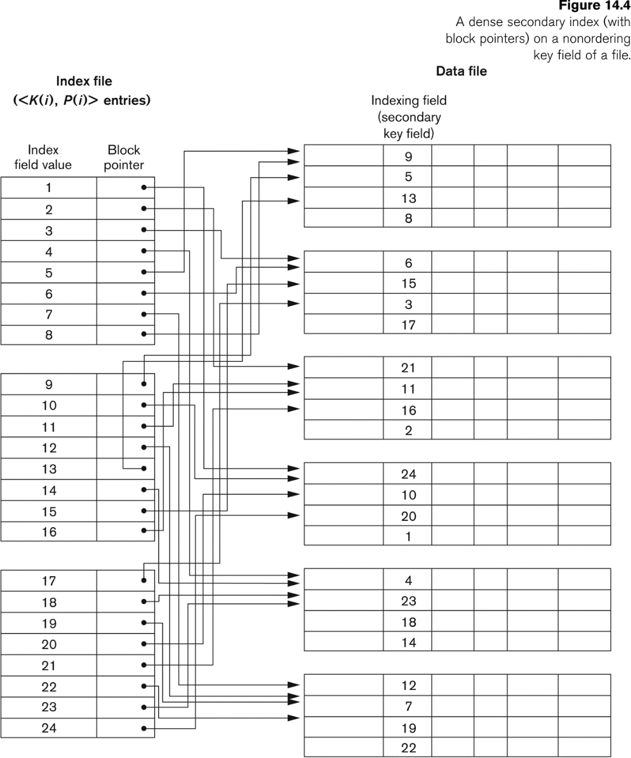
Example of a Dense Secondary Index

Slide 14
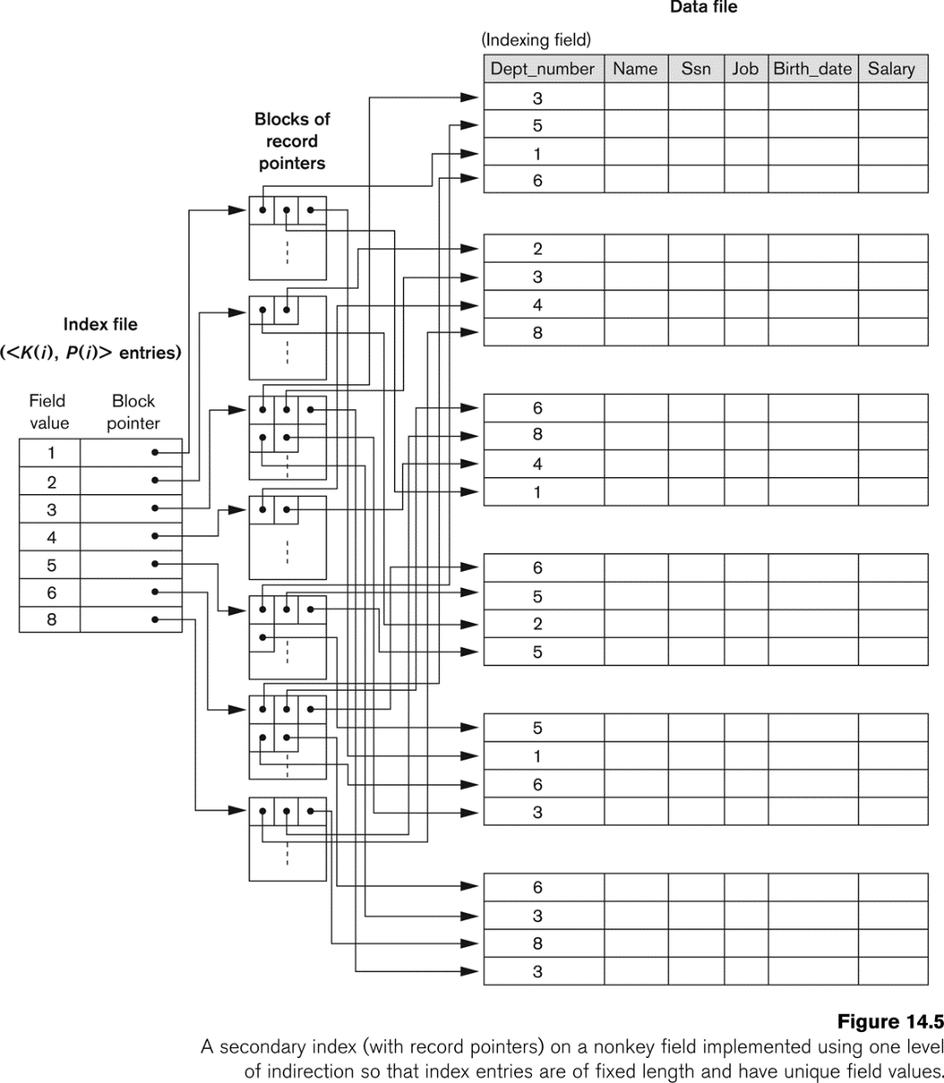
An Example of a Secondary Index

Slide 15
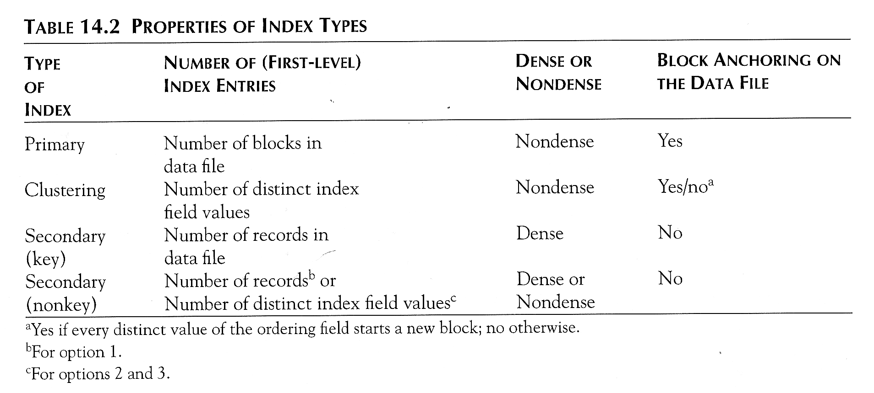
Properties of Index Types

Slide 16
Multi-Level Indexes
Because a single-level index is an ordered file, we can create a primary index to the index itself;
  In this case, the original index file is called the first-level index and the index to the index is called the second-level index.
We can repeat the process, creating a third, fourth, ..., top level until all entries of the top level fit in one disk block
A multi-level index can be created for any type of first-level index (primary, secondary, clustering) as long as the first-level index consists of more than one disk block
If first level has r1 entries and blocking factor bfri = f0
r2 = ceiling (r1/f0), r3 = ceiling(r2/f0)…
Total levels needed t = ceiling(log_{f0}(r1))

Slide 17
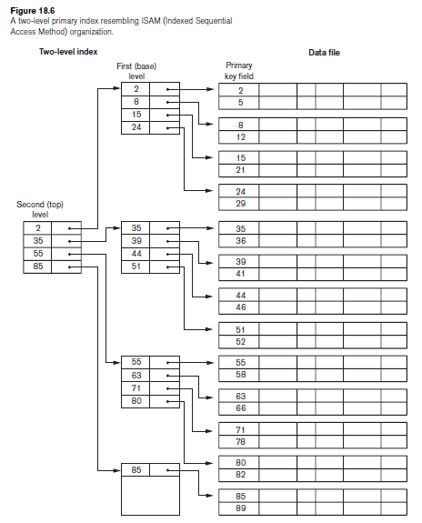
A Two-level Primary Index

Slide 18
Multi-Level Indexes
Such a multi-level index is a form of search tree
  However, insertion and deletion of new index entries is a severe problem because every level of the index is an ordered file.
Thus far - indexing uses an ordered index file, binary search (log2bi) to locate pointers to a disk block/record, algorithm reduces the part of the index file that we continue to search by a factor of 2.
multilevel index - reduce the search by bfri (blocking factor fan-out (fo) ), which is larger than 2. search space reduced much faster. Instead of two halves at each step, record search space is divided into n-ways (where n = fan-out), requires approximately (logfobi) block accesses, which is a substantially smaller. In most cases, the fan-out is much larger than 2.
Slide 14- <number>

Slide 19
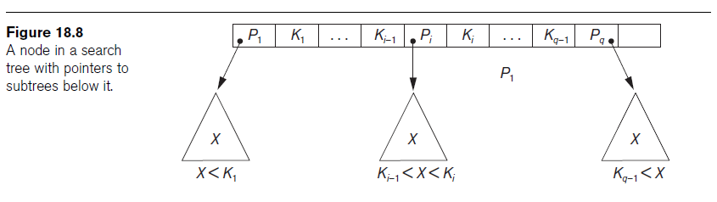
A Node in a Search Tree with Pointers to Subtrees below It
A search tree of order p is a tree such that each node contains at most p − 1 search values and p pointers in the order <P1, K1, P2, K2, ..., Pq−1, Kq−1, Pq>, where q ≤ p. Each Pi is a pointer to a child node (or a NULL pointer), and each Ki is a search value
Slide 14- <number>

Slide 20
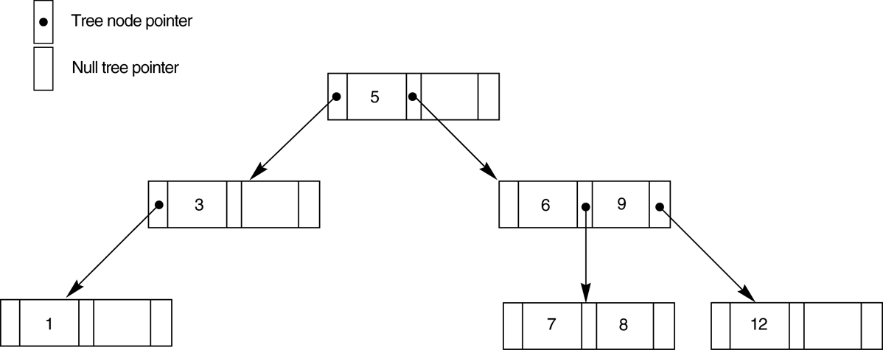
FIGURE 14.9
A search tree of order p = 3.
Slide 14- <number>

Slide 21
Dynamic Multilevel Indexes Using B-Trees and B+-Trees
Most multi-level indexes use B-tree or B+-tree data structures because of the insertion and deletion problem
  This leaves space in each tree node (disk block) to allow for new index entries
These data structures are variations of search trees that allow efficient insertion and deletion of new search values.
In B-Tree and B+-Tree data structures, each node corresponds to a disk block
Each node is kept between half-full and completely full
Slide 14- <number>

Slide 22
Dynamic Multilevel Indexes Using B-Trees and B+-Trees (contd.)
An insertion into a node that is not full is quite efficient
  If a node is full the insertion causes a split into two nodes
Splitting may propagate to other tree levels
A deletion is quite efficient if a node does not become less than half full
If a deletion causes a node to become less than half full, it must be merged with neighboring nodes
Slide 14- <number>

Slide 23
Difference between B-tree and B+-tree
In a B-tree, pointers to data records exist at all levels of the tree
In a B+-tree, all pointers to data records exists at the leaf-level nodes
A B+-tree can have less levels (or higher capacity of search values) than the corresponding B-tree
Slide 14- <number>

Slide 24
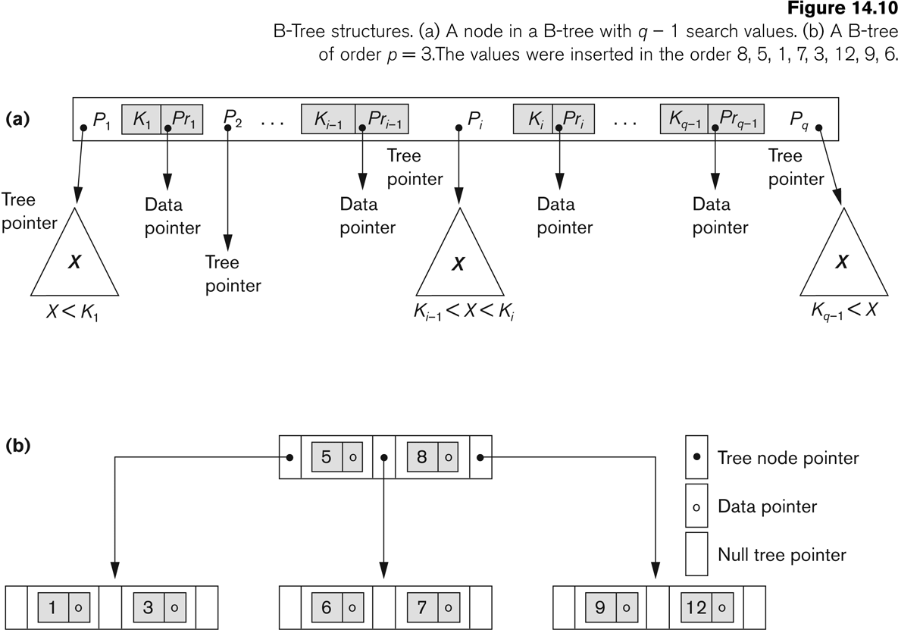
B-tree Structures
Slide 14- <number>

Slide 25
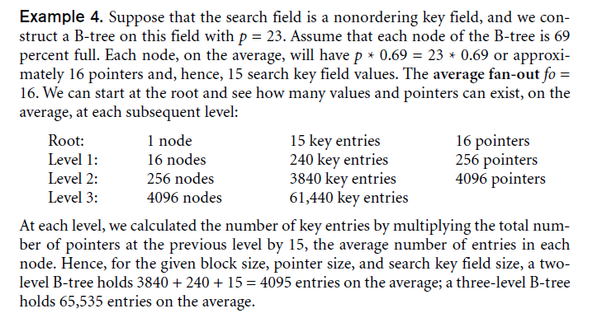
B-tree example
Slide 14- <number>

Slide 26
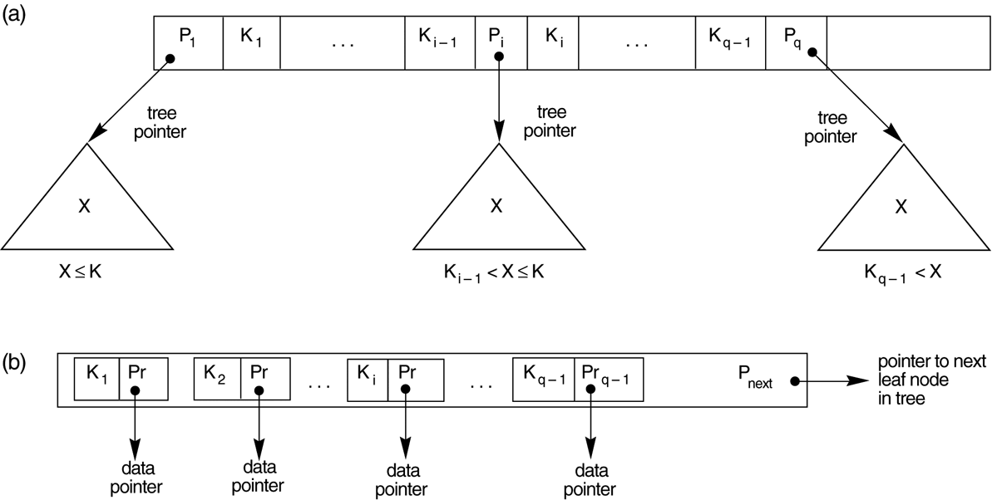
The Nodes of a B+-tree
B+-tree
  (a) Internal node of a B+-tree with q –1 search values.
  (b) Leaf node of a B+-tree with q – 1 search values and q – 1 data pointers.
Slide 14- <number>

Slide 27
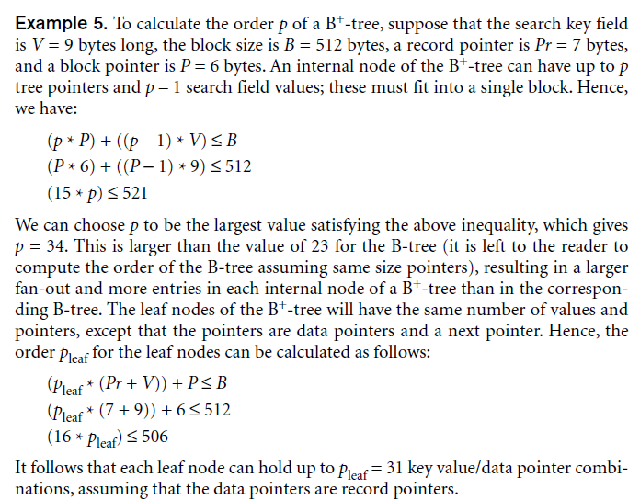
B+-tree Example
Slide 14- <number>

Slide 28
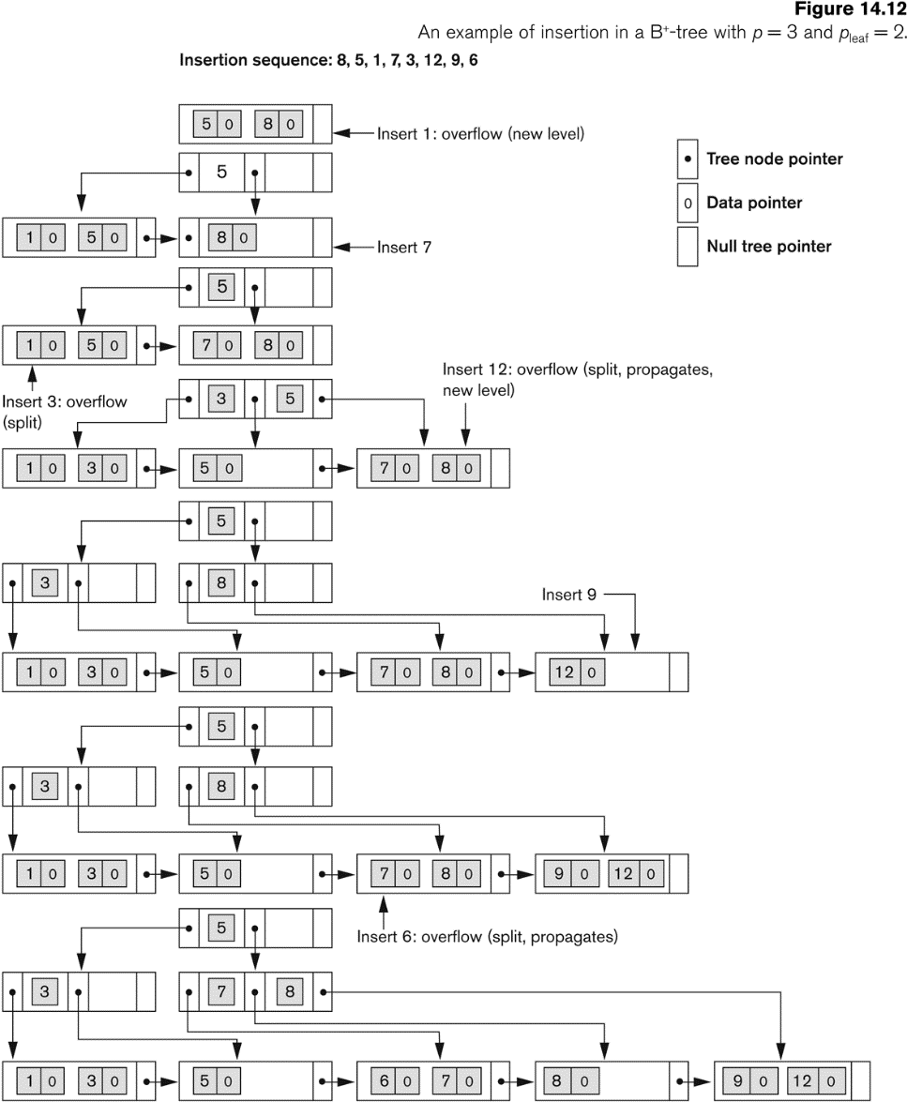
An Example of an Insertion in a B+-tree
Slide 14- <number>

Slide 29
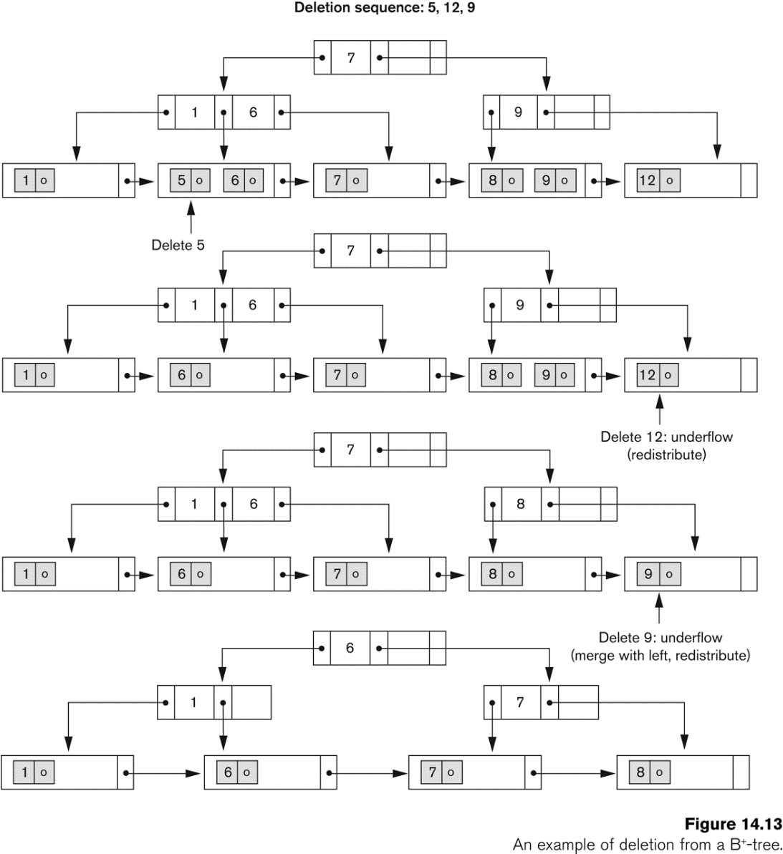
An Example of a Deletion in a B+-tree
Slide 14- <number>

Slide 30
Summary
Types of Single-level Ordered Indexes
  Primary Indexes
  Clustering Indexes
  Secondary Indexes
Multilevel Indexes
Dynamic Multilevel Indexes Using B-Trees and B+-Trees
Indexes on Multiple Keys
Slide 14- <number>

